Slide 1

Unit – CAPTCHA, Firewalls & Intrusion Detection
CAPTCHA, Firewalls & Intrusion Detection
CAPTCHA • Firewall • Classifications • Personal Firewall • IDS

Slide 2
Learning Objectives
Define CAPTCHA and explain why websites use it.
Understand the purpose and basic operation of a firewall.
Explain major firewall classifications and when each is useful.
Understand personal firewalls and their role on individual devices.
Define intrusion detection and distinguish IDS from a firewall.
Explain network-based and host-based IDS, and signature-based versus anomaly-based detection.
Use practical examples and compare security controls.

Slide 3
CAPTCHA — Definition
CAPTCHA stands for Completely Automated Public Turing test to tell Computers and Humans Apart.
It is a challenge-response mechanism designed to distinguish a human user from automated software.
CAPTCHAs are commonly placed at account creation, login, form submission, comment posting or other abuse-sensitive actions.
The underlying goal is not to prove a person's identity; it is to reduce automated abuse.
Modern CAPTCHA systems may use visual, audio or behavioral challenges, and some may work with minimal visible interaction.

Slide 4
Why CAPTCHA Is Used
CAPTCHA / risk
challenge
User / Bot
submits request
Challenge
response
Allow /
challenge
Purpose: CAPTCHA is mainly an anti-automation control. A real attacker may still pass it, so rate limits and other defenses are also needed.

Slide 5
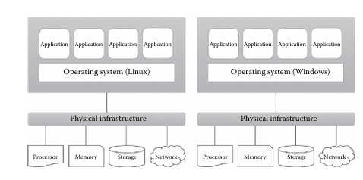
CAPTCHA — Common Types
Text/image CAPTCHA: the user identifies distorted text, objects or characters.
Image-selection CAPTCHA: the user selects images matching an instruction.
Audio CAPTCHA: an audio challenge can provide an accessibility alternative.
Behavior/risk-based CAPTCHA: the system evaluates interaction signals and risk, sometimes avoiding an explicit puzzle.
CAPTCHA design changes over time because attackers also develop automated solving techniques.

Slide 6
CAPTCHA Example — Online Registration
Scenario: a website allows anyone to create a new account.
Problem: an automated bot can submit thousands of registration requests.
Control: the site may present a CAPTCHA or other risk-based challenge before accepting the request.
Human user completes the challenge → request continues.
Automated or suspicious request → challenge may fail, require stronger verification, or be rate-limited.
CAPTCHA is only one control; it should be combined with rate limiting, abuse detection and secure application design.

Slide 7
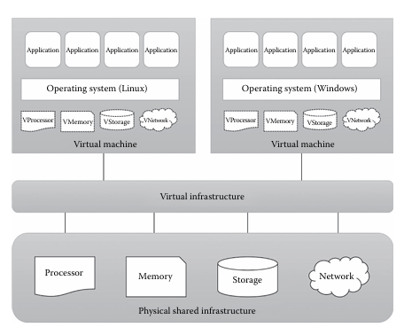
CAPTCHA — Advantages & Limitations
Benefit | Limitation
Reduces simple automated submissions | Can inconvenience legitimate users
Adds friction to high-abuse actions | Accessibility must be considered
Can slow large-scale bot activity | Automated solving can sometimes defeat weak CAPTCHAs
Works as one layer in abuse prevention | Not an identity-authentication mechanism
Best practice: Use CAPTCHA selectively with rate limiting, monitoring and secure application controls.

Slide 8
Firewall — Definition
A firewall is a security control that monitors and controls network traffic according to a defined security policy.
It can allow, block, reject or otherwise handle traffic based on characteristics such as source, destination, protocol, port, connection state or application information.
Firewalls can be implemented in hardware, software, cloud services or network appliances.
The central idea is controlled traffic flow between a trusted environment and a less-trusted environment.
A firewall is not a complete security solution; threats can arrive through permitted traffic, compromised credentials or applications.

Slide 9
Basic Firewall Operation
FIREWALL
Security policy
Rules + inspection
Internet /
Untrusted network
Internal /
Protected network
ALLOW
BLOCK / REJECT
Key idea: The firewall applies an organization's traffic policy; it does not automatically make every permitted application safe.

Slide 10
Firewall Rules — Simple Example
Rule 1: allow established/related traffic that belongs to permitted connections.
Rule 2: allow required application traffic, such as a web service, only where the policy permits it.
Rule 3: block unnecessary inbound services.
Rule 4: log selected denied or suspicious traffic for monitoring.
Rule order matters in many firewall systems: a packet may be handled by the first matching rule.
Good rules follow least privilege: allow what is needed and deny what is not required.

Slide 11
Firewall Classification — Overview
Packet
Filtering
Stateful
Inspection
Circuit-Level
Gateway
Application
Proxy
NGFW
Concept
Inspection context generally becomes richer as the firewall moves from simple headers toward state and application awareness.
Note: These categories can overlap in real products. A modern firewall may combine several capabilities.

Slide 12
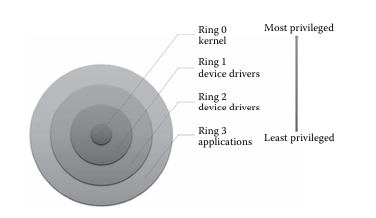
Packet-Filtering Firewall
Packet filtering examines packet/header information such as source and destination IP address, protocol and port.
It can make fast decisions using simple rules.
Advantages: relatively simple, efficient and widely applicable.
Limitations: basic stateless filtering may not understand the full context of a connection or application.
Example: block inbound TCP connections to a server port that should not be publicly reachable.

Slide 13
Stateful Inspection Firewall
A stateful firewall keeps track of active connections or flows.
It can distinguish packets that belong to an established connection from unexpected packets.
This provides more context than simple stateless packet filtering.
Example: after an allowed outbound TCP connection is established, the corresponding return traffic can be permitted because it matches the tracked state.
Stateful inspection is common in modern network firewalls.

Slide 14
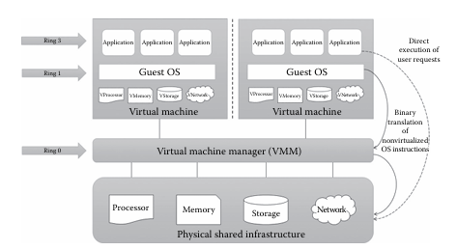
Application-Level Gateway / Proxy Firewall
An application proxy acts as an intermediary between a client and a server.
It can understand application-layer protocols and inspect traffic using protocol-specific rules.
Because the proxy terminates and creates separate connections, it can hide internal network details and enforce detailed application policies.
Advantages: deep application awareness and policy control.
Limitations: more processing, configuration complexity and possible protocol/application compatibility issues.

Slide 15
Circuit-Level Gateway
A circuit-level gateway controls connections or sessions rather than inspecting every application payload in detail.
It can establish a controlled communication circuit between internal and external systems.
It may verify session-level information and hide internal addresses.
Compared with an application proxy, it generally provides less application-content inspection.
Teaching point: think 'connection/session control' rather than full application inspection.

Slide 16
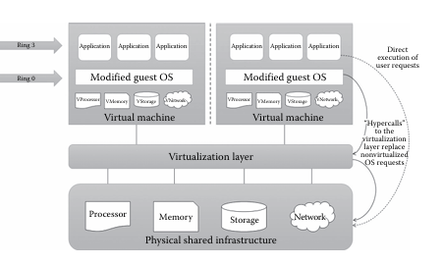
Next-Generation Firewall — Concept
Next-generation firewalls (NGFWs) extend traditional firewalling with deeper application and security-awareness capabilities.
Depending on the product, capabilities can include application identification, user-aware policy, integrated intrusion prevention and encrypted-traffic handling.
NGFW is a product/architecture category rather than one universal technical specification.
Deep inspection can improve visibility but may add processing overhead and configuration complexity.
Security teams should enable only capabilities that support a clear security requirement.

Slide 17
Personal Firewall — Definition
A personal firewall is firewall software or an equivalent host-based control running on an individual computer or device.
It controls traffic to and/or from that device based on local security policy.
It can help block unwanted inbound connections and, depending on the implementation, restrict outbound applications.
Personal firewalls are useful on laptops because the device may move between trusted and untrusted networks.
They complement—not replace—patching, endpoint protection, secure applications and user awareness.

Slide 18
Personal Firewall Example
Personal Firewall
on device
Internet
Laptop /
PC
The host firewall can control traffic to and, depending on policy, from the individual device.
Example: On public Wi‑Fi, a personal firewall can reduce exposure to unwanted inbound connections.

Slide 19
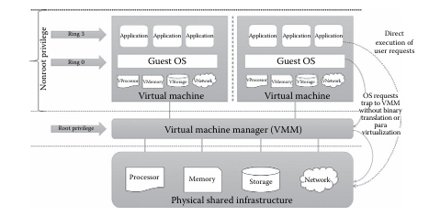
Firewall Advantages & Limitations
Strength | Limitation
Controls network access using policy | Cannot stop every attack through allowed traffic
Can reduce exposed services | Misconfiguration can create security gaps
Can log traffic decisions | Logs need monitoring and analysis
Can enforce segmentation | Encrypted traffic may limit visibility unless inspected safely
Remember: Firewall security depends on correct policy, configuration, maintenance and monitoring.

Slide 20
Intrusion Detection — Definition
Intrusion Detection is the process of monitoring systems or networks to identify suspicious activity, policy violations or signs of attacks.
An Intrusion Detection System (IDS) observes activity and generates alerts; it is primarily a detection and notification control.
IDS can use network traffic, host events, logs, system calls or other telemetry as evidence.
Detection does not automatically mean compromise: an alert is an indication that requires analysis.
IDS works alongside preventive controls such as firewalls and access controls.

Slide 21
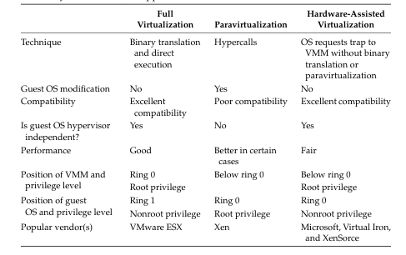
IDS vs Firewall
Firewall
ALLOW / BLOCK
IDS
MONITOR / ALERT
Network
Traffic
Analyst /
Response
Difference: Firewall mainly enforces preventive traffic policy. IDS primarily detects suspicious activity and raises alerts for investigation.

Slide 22
Types of IDS by Location
Network-based IDS (NIDS): monitors network traffic at selected points to identify suspicious patterns.
Host-based IDS (HIDS): monitors activity on an individual host, such as logs, processes, file changes or system events.
Some deployments combine multiple sensors and centralized analysis.
NIDS provides network-level visibility; HIDS can see host-specific activity that may not be visible from network traffic alone.
Choosing placement depends on the assets, traffic visibility and threat model.

Slide 23
Signature-Based Detection
Signature-based IDS compares observed activity with known patterns or signatures of malicious behavior.
Strength: effective for known threats when signatures are accurate and current.
Limitation: a genuinely new or significantly modified attack may not match a known signature.
Signature databases therefore need updates and tuning.
Example: a known malicious packet sequence or file pattern triggers an alert.

Slide 24
Anomaly-Based Detection
Anomaly-based IDS establishes a model of normal or expected behavior and flags significant deviations.
Strength: can help identify previously unseen or unusual activity.
Limitation: unusual legitimate behavior can create false positives.
Models require good baselines and careful tuning.
Example: a server suddenly generating an unusual volume of outbound traffic compared with its normal pattern.

Slide 25
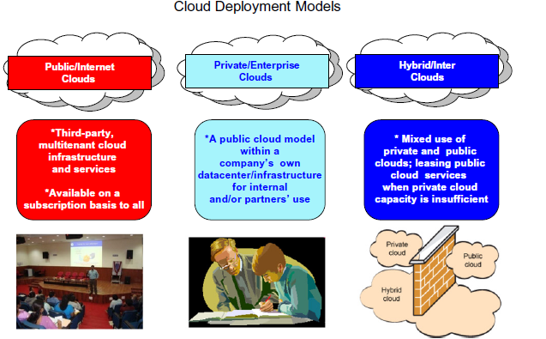
Hybrid Detection & Alert Handling
Many practical IDS deployments combine signature/rule-based and anomaly/behavior-based methods.
Alerts can be prioritized using severity, asset importance, confidence and supporting evidence.
Security analysts investigate alerts to distinguish true incidents from false positives.
Logs and alerts should be protected, retained appropriately and correlated with other security telemetry.
An IDS becomes more valuable when alerts lead to a documented response process.

Slide 26
Real-Life Example — Web Server Protection
Firewall: blocks unnecessary ports and restricts network paths.
IDS: watches traffic and host events for suspicious scanning, exploit patterns or abnormal behavior.
Application security: validates inputs and protects the web application itself.
Monitoring: records and correlates alerts so an administrator can investigate.
Lesson: layered security uses different controls for prevention, detection and response.

Slide 27
Security Controls — Comparison
Control | Primary purpose | Typical evidence/action
CAPTCHA | Reduce automated abuse | Challenge / risk assessment
Firewall | Prevent or restrict unwanted traffic | Allow, block, reject, log
Personal firewall | Protect one endpoint | Host traffic rules
NIDS | Detect network threats | Network traffic alerts
HIDS | Detect host threats | Logs, files, processes, events
Exam tip: Remember the roles: CAPTCHA = anti-automation; Firewall = traffic control; IDS = detection.

Slide 28
Important Exam Points
CAPTCHA reduces automated abuse; it is not an identity-authentication mechanism.
Firewall = traffic control according to a security policy.
Packet filtering uses packet/header information; stateful inspection tracks connection state.
Proxy/application gateways can inspect and control application-layer traffic.
Personal firewall protects an individual host.
IDS detects and alerts on suspicious activity; a firewall primarily controls traffic.
NIDS monitors network activity; HIDS monitors host activity.
Signature detection is strong for known patterns; anomaly detection can identify deviations from a baseline.

Slide 29
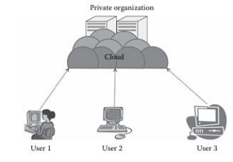
Exam Questions — Short Answers
Q1. What is CAPTCHA? — A challenge-response mechanism intended to distinguish humans from automated software.
Q2. What is a firewall? — A control that monitors and regulates network traffic according to policy.
Q3. What is stateful inspection? — Firewalling that tracks active connection state when making traffic decisions.
Q4. What is a personal firewall? — A host-based firewall running on an individual device.
Q5. What is IDS? — A system that monitors activity to detect and alert on suspicious events.
Q6. Difference between NIDS and HIDS? — NIDS focuses on network activity; HIDS focuses on activity within a host.
Q7. Signature vs anomaly detection? — Known patterns versus deviations from expected behavior.

Slide 30
Quick Revision
CAPTCHA → reduce bot/automated abuse.
Firewall → enforce traffic-control policy.
Stateless packet filter → header-based rules.
Stateful firewall → connection-aware rules.
Proxy/application gateway → intermediary with application-level visibility.
Personal firewall → protection on an individual endpoint.
IDS → detection and alerting.
NIDS → network; HIDS → host.
Signature → known pattern; anomaly → deviation from baseline.

Slide 31
Unit Summary
CAPTCHA helps websites reduce automated abuse but does not establish user identity.
Firewalls create controlled boundaries by allowing or blocking traffic according to policy.
Firewall classifications differ in how much context they inspect, from packet headers to application-layer information.
Personal firewalls extend traffic control to individual endpoints.
IDS provides visibility and alerts about suspicious behavior and complements preventive controls.
Effective security uses layered controls rather than relying on one mechanism.

Slide 32
Thank You
Thank You
Questions / Discussion
Final thought: Use prevention, detection and response together—no single security control can stop every threat.

